Slide 1

Chapter 3: roadmap
Transport-layer services
Multiplexing and demultiplexing
Connectionless transport: UDP
Principles of reliable data transfer
Connection-oriented transport: TCP
segment structure
reliable data transfer
flow control
connection management
Principles of congestion control
TCP congestion control

Slide 2
TCP: overview RFCs: 793,1122, 2018, 5681, 7323
point-to-point:
one sender, one receiver
reliable, in-order byte steam:
no “message boundaries"
full duplex data:
bi-directional data flow in same connection
MSS: maximum segment size
cumulative ACKs
pipelining:
TCP congestion and flow control set window size
connection-oriented:
handshaking (exchange of control messages) initializes sender, receiver state before data exchange
flow controlled:
sender will not overwhelm receiver
Notes:
between a single sender and a single receiver. The transfer of data from one sender to many receivers in a single send operation is not possible
Typical MSS is 1460 bytes

Slide 3
TCP connection
TCP connection consists of
Buffers and variables
a socket connection to a process in one host, and another set of buffers, variables, and a socket connection to a process in another host.
Nothing is stored in the network elements (routers, switches, and repeaters) between the hosts.
Notes:
TCP connection is logical one. NOT like TDM or FDM circuit as in Circuit switched networks in which states are reserved in intermediate nodes or elements. TCP connection is logical one where common states are only stored on end system. So intermediate nodes or routers have no idea about TCP connections.

Slide 4
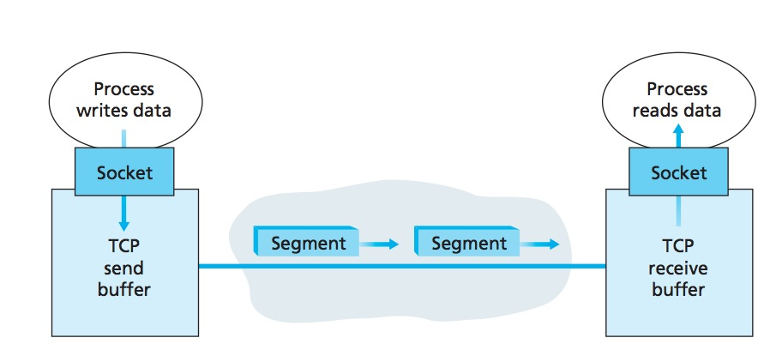
TCP Send/Receive buffers
The client process passes a stream of data through the socket.
Once the data passes through the Socket, the data is in the hands of TCP
running in the client.
TCP directs this data to the connection’s send buffer, which is one of the
buffers that is set aside during the initial three-way handshake.
From time to time, TCP will grab chunks of data from the send buffer and
pass the data to the network layer.
Notes:
Remember client process is one that initiates the connection.

Slide 5
TCP segment structure
32 bits
source port #
dest port #
segment seq #: counting bytes of data into bytestream (not segments!)
ACK: seq # of next expected byte; A bit: this is an ACK
sequence number
acknowledgement number
length (of TCP header)
head
len
not
used
A
P
S
receive window
flow control: # bytes receiver willing to accept
C
E
U
R
F
Internet checksum
checksum
Urg data pointer
options (variable length)
C, E: congestion notification
TCP options
application
data
(variable length)
data sent by application into TCP socket
RST, SYN, FIN: connection management

Slide 6
TCP sequence numbers, ACKs
outgoing segment from sender
Sequence numbers:
byte stream “number” of first byte in segment’s data
source port #
dest port #
sequence number
acknowledgement number
rwnd
checksum
urg pointer
window size
N
Acknowledgements:
seq # of next byte expected from other side
cumulative ACK
sender sequence number space
sent
ACKed
sent, not-yet ACKed
(“in-flight”)
usable
but not
yet sent
not
usable
Q: how receiver handles out-of-order segments
A: TCP spec doesn’t say, - up to implementor
outgoing segment from receiver
source port #
dest port #
sequence number
acknowledgement number
A
rwnd
checksum
urg pointer

Slide 7
Sequence Numbers
TCP views data as an unstructured, but ordered, stream of bytes.
Sequence numbers are over the stream of transmitted bytes and not over the series of transmitted segments.
The sequence number for a segment is therefore the byte-stream number of the first byte in the segment.

Slide 8
An example
A process in Host A wants to send a stream of data to a process in Host B.
The TCP in Host A will implicitly number each byte in the data stream.
For a file consisting of 500,000 bytes,
MSS being 1,000 bytes, and that the first byte of the data stream is numbered 0.
TCP constructs 500 segments out of the data stream.

Slide 9
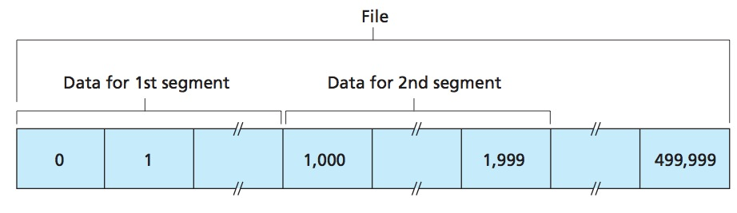
TCP Sequence Numbers
The first segment gets assigned sequence number 0, the second segment gets assigned sequence number 1,000, the third segment gets assigned sequence number 2,000, and so on.

Slide 10
Full duplex
TCP is full-duplex, so that Host A may be receiving data from Host B while it sends data to Host B (as part of the same TCP connection).
Data for B
A
Data for A
ACK
B
ACK

Slide 11
Acknowledgment numbers
A sends a segment to B, what would B put in the Ack sequence number in the next segment it sends to A?
next byte Host B is expecting from Host A.
A sends a segment to B, what would A put in the Ack sequence number in the next segment it sends to B?
next byte Host A is expecting from Host B.

Slide 12
An example
Host A has received all bytes numbered 0 through 535 from B.
Host A is waiting for byte 536 and all the subsequent bytes in Host B’s data stream.
What does Host A put in the acknowledgment number field of the next segment it sends to B?
Host A puts 536 in the acknowledgment number
field of the segment it sends to B

Slide 13
Another example
Host A has received all bytes numbered 0 through 535 from B.
Host A has also received another segment containing bytes 900 through 1,000
For some reason Host A has not yet received bytes 536 through 899.
What does Host A put in the acknowledgment number field of the next segment it sends to B?
A’s next segment to B will contain 536 in the acknowledgment
number field

Slide 14
Out of order segments
TCP only acknowledges bytes up to the first missing byte in the stream, TCP is said to provide cumulative acknowledgments.
For out of order segments it can either discard them or buffer them (the approach actually taken in practice)

Slide 15
The seg/ack numbers base
we assumed that the initial sequence number was zero.
In truth, both sides of a TCP connection randomly choose an initial sequence number.
Why?
Notes:
This is done to minimize the possibility that a segment that is still present in the network from an earlier, already-terminated connection between two hosts is mistaken for a valid segment in a later connection between these same two hosts (which also happen to be using the same port numbers as the old connection)

Slide 16

TCP sequence numbers, ACKs
Host A
Host B
User types‘C’
Seq=42, ACK=79, data = ‘C’
host ACKs receipt of‘C’, echoes back ‘C’
Seq=79, ACK=43, data = ‘C’
host ACKs receipt of echoed ‘C’
Seq=43, ACK=80
simple telnet scenario
Notes:
The key thing to note here is that the ACK number (43) on the B-to-A segment is one more than the sequence number (42) on the A-toB segment that triggered that ACK
Similarly, the ACK number (80) on the last A-to-B segment is one more than the sequence number (79) on the B-to-A segment that triggered that ACK

Slide 17
TCP round trip time, timeout
Q: how to set TCP timeout value?
longer than RTT
but RTT varies
too short: premature timeout, unnecessary retransmissions
too long: slow reaction to segment loss
Q: how to estimate RTT?
SampleRTT: measured time from segment transmission until ACK receipt
ignore retransmissions
SampleRTT will vary, want estimated RTT “smoother”
average several recent measurements, not just current SampleRTT

Slide 18
TCP round trip time, timeout
EstimatedRTT = (1- α)*EstimatedRTT + α*SampleRTT
exponential weighted moving average
influence of past sample decreases exponentially fast
typical value: α = 0.125
RTT: gaia.cs.umass.edu to fantasia.eurecom.fr
RTT (milliseconds)
sampleRTT
EstimatedRTT

Slide 19

TCP round trip time, timeout
timeout interval: EstimatedRTT plus “safety margin”
large variation in EstimatedRTT -> larger safety margin
estimate SampleRTT deviation from EstimatedRTT:
DevRTT = (1-β)*DevRTT +
β*|SampleRTT-EstimatedRTT|
(typically, β = 0.25)
TimeoutInterval = EstimatedRTT + 4*DevRTT
estimated RTT
“safety margin”

Slide 20
TCP reliable data transfer
TCP creates rdt service on top of IP’s unreliable service
pipelined segments
cumulative acks
single retransmission timer
Retransmissions triggered by:
timeout events
duplicate acks
let’s initially consider simplified TCP sender

Slide 21
TCP Sender (simplified)
event: data received from application
create segment with seq #
seq # is byte-stream number of first data byte in segment
start timer if not already running
think of timer as for oldest unACKed segment
expiration interval: TimeOutInterval
event: timeout
retransmit segment that caused timeout
restart timer
event: ACK received
if ACK acknowledges previously unACKed segments
update what is known to be ACKed
start timer if there are still unACKed segments
Notes:
Given these details of TCP sequence numbers, acks, and timers, we can now describe the big picture view of how the TCP sender and receiver operate
You can check out FSMs in book; let’s just give an English text description here and let’s start with the sender.

Slide 22
TCP sender (simplified)
data received from application above
create segment, seq. #: NextSeqNum
pass segment to IP (i.e., “send”)
NextSeqNum = NextSeqNum + length(data)
if (timer currently not running)
start timer
Λ
NextSeqNum = InitialSeqNum
SendBase = InitialSeqNum
wait
for
event
timeout
retransmit not-yet-acked segment with smallest seq. #
start timer
ACK received, with ACK field value y
if (y > SendBase) {
SendBase = y
/* SendBase–1: last cumulatively ACKed byte */
if (there are currently not-yet-acked segments)
start timer
}

Slide 23
TCP: retransmission scenarios
Host A
Host B
Host A
Host B
SendBase=92
Seq=92, 8 bytes of data
Seq=92, 8 bytes of data
timeout
timeout
Seq=100, 20 bytes of data
ACK=100
X
ACK=100
ACK=120
Seq=92, 8 bytes of data
Seq=92, 8
bytes of data
SendBase=100
SendBase=120
ACK=100
ACK=120
SendBase=120
lost ACK scenario
premature timeout

Slide 24
TCP: retransmission scenarios
Host A
Host B
Seq=92, 8 bytes of data
Seq=100, 20 bytes of data
timeout
ACK=100
X
ACK=120
Seq=120, 15 bytes of data
cumulative ACK

Slide 25
Modified TCP – Doubling Timeout Interval
Whenever the timeout event occurs it sets the next timeout interval to twice the previous value,
rather than deriving it from the last EstimatedRTT and DevRTT
However, in case of other two events (app data received or ACK received), it is derived.
It also provides a limited form of congestion control.
Timer expiration due to congestion
It is better to wait rather than keep sending
Notes:
For example, suppose TimeoutInterval associated with the oldest not yet acknowledged segment is .75 sec when the timer first expires. TCP will then retransmit this segment and set the new expiration time to 1.5 sec. If the timer expires again 1.5 sec later, TCP will again retransmit this segment, now setting the expiration time to 3.0 sec.

Slide 26
Modified TCP – Fast Retransmit
Timeout-triggered retransmissions can take long
Duplicate ACKs can help sender to detect packet loss
A duplicate ACK is an ACK that reacknowledges a segment for which the sender has already received an earlier acknowledgment.
When it is sent/received?

Slide 27

TCP fast retransmit
Host A
Host B
TCP fast retransmit
if sender receives 3 additional ACKs for same data (“triple duplicate ACKs”), resend unACKed segment with smallest seq #
likely that unACKed segment lost, so don’t wait for timeout
Seq=92, 8 bytes of data
Seq=100, 20 bytes of data
X
ACK=100
timeout
ACK=100
ACK=100
Receipt of three duplicate ACKs indicates 3 segments received after a missing segment – lost segment is likely. So retransmit!
ACK=100
Seq=100, 20 bytes of data
Notes:
Let’s wrap up our study of TCP reliability by discussing an optimization to the original TCP known as TCP fast retransmit,
Take a look at this example on the right where 5 segments are transmitted and the second segment is lost. In this case the TCP receiver sends an ACK 100 acknowledging the first received segment.
When the third segment arrives at the receiver, the TCP receiver sends another ACK 100 since the second segment has not arrived. And similarly for the 4th and 5th segments to arrive.
Now what does the sender see? The sender receives the first ACK 100 it has been hoping for, but then three additional duplicate ACK100s arrive. The sender knows that somethings’ wrong – it knows the first segment arrived at the receiver but three later arriving segments at the receiver – the ones that generated the three duplicate ACKs – we received correctly but were not in order. That is, that there was a missing segment at the receiver when each of the three duplicate ACK were generated.
With fast retransmit, the arrival of three duplicate ACK causes the sender to retransmit its oldest unACKed segment, without waiting for a timeout event. This allows TCP to recover more quickly from what is very likely a loss event
specifically that the second segment has been lost, since three higher -numbered segments were received

Slide 28
TCP Receiver: ACK generation [RFC 5681]
Event at receiver
arrival of in-order segment with
expected seq #. All data up to
expected seq # already ACKed
arrival of in-order segment with
expected seq #. One other
segment has ACK pending
arrival of out-of-order segment
higher-than-expect seq. # .
Gap detected
arrival of segment that
partially or completely fills gap
TCP receiver action
delayed ACK. Wait up to 500ms
for next segment. If no next segment,
send ACK
immediately send single cumulative
ACK, ACKing both in-order segments
immediately send duplicate ACK,
indicating seq. # of next expected byte
immediate send ACK, provided that
segment starts at lower end of gap
Notes:
Rather than immediately ACKnowledig this segment, many TCP implementations will wait for half a second for another in-order segment to arrive, and then generate a single cumulative ACK for both segments – thus decreasing the amount of ACK traffic. The arrival of this second in-order segment and the cumulative ACK generation that covers both segments is the second row in this table.

Slide 29
TCP Receiver: ACK generation [RFC 5681]
Event at receiver
arrival of in-order segment with
expected seq #. All data up to
expected seq # already ACKed
arrival of in-order segment with
expected seq #. One other
segment has ACK pending
arrival of out-of-order segment
higher-than-expect seq. # .
Gap detected
arrival of segment that
partially or completely fills gap
TCP receiver action
delayed ACK. Wait up to 500ms
for next segment. If no next segment,
send ACK
immediately send single cumulative
ACK, ACKing both in-order segments
immediately send duplicate ACK,
indicating seq. # of next expected byte
immediate send ACK, provided that
segment starts at lower end of gap
Notes:
Rather than immediately ACKnowledig this segment, many TCP implementations will wait for half a second for another in-order segment to arrive, and then generate a single cumulative ACK for both segments – thus decreasing the amount of ACK traffic. The arrival of this second in-order segment and the cumulative ACK generation that covers both segments is the second row in this table.

Slide 30
TCP flow control
application
process
Q: What happens if network layer delivers data faster than application layer removes data from socket buffers?
Application removing data from TCP socket buffers
TCP socket
receiver buffers
TCP
code
Network layer delivering IP datagram payload into TCP socket buffers
IP
code
from sender
receiver protocol stack
Notes:
(Presuming an intro)
Before diving into the details of TCP flow control, let’s first get the general context and motivate the need for flow control.
This diagram show a typical transport-layer implementation
A segment is brought up the protocol stack to the transport layer, and the segment’s payload is removed from the segment and written INTO socket buffers.
How does data get taken OUT of socket buffers? By applications performing socket reads, as we learned in Chapter 2.
And so the question is “What happens if network layer delivers data faster than an application-layer process removes data from socket buffers?”
Let’s watch a video of what happens when things arrive way too fast to fast to be processed.
<video>. (I love that video). Another human analogy showing the need for flow control is the saying – to use some English slang - “no one can drink from a firehose”
Flow control is a mechanism to the calamity of a receiver being over-run by a sender that is sending too fast – it allows the RECEIVER to explictly control the SENDER so sender won’t overflow receiver’s buffer by transmitting too much, too fast

Slide 31

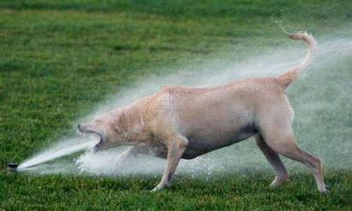
TCP flow control
application
process
Q: What happens if network layer delivers data faster than application layer removes data from socket buffers?
Application removing data from TCP socket buffers
TCP socket
receiver buffers
TCP
code
Network layer delivering IP datagram payload into TCP socket buffers
IP
code
from sender
receiver protocol stack
Notes:
(Presuming an intro)
Before diving into the details of TCP flow control, let’s first get the general context and motivate the need for flow control.
This diagram show a typical transport-layer implementation
A segment is brought up the protocol stack to the transport layer, and the segment’s payload is removed from the segment and written INTO socket buffers.
How does data get taken OUT of socket buffers? By applications performing socket reads, as we learned in Chapter 2.
And so the question is “What happens if network layer delivers data faster than an application-layer process removes data from socket buffers?”
Let’s watch a video of what happens when things arrive way too fast to fast to be processed.
<video>. (I love that video). Another human analogy showing the need for flow control is the saying – to use some English slang - “no one can drink from a firehose”
Flow control is a mechanism to the calamity of a receiver being over-run by a sender that is sending too fast – it allows the RECEIVER to explictly control the SENDER so sender won’t overflow receiver’s buffer by transmitting too much, too fast

Slide 32
TCP flow control
application
process
Q: What happens if network layer delivers data faster than application layer removes data from socket buffers?
Application removing data from TCP socket buffers
TCP socket
receiver buffers
TCP
code
receive window
flow control: # bytes receiver willing to accept
IP
code
from sender
receiver protocol stack
Notes:
(Presuming an intro)
Before diving into the details of TCP flow control, let’s first get the general context and motivate the need for flow control.
This diagram show a typical transport-layer implementation
A segment is brought up the protocol stack to the transport layer, and the segment’s payload is removed from the segment and written INTO socket buffers.
How does data get taken OUT of socket buffers? By applications performing socket reads, as we learned in Chapter 2.
And so the question is “What happens if network layer delivers data faster than an application-layer process removes data from socket buffers?”
Let’s watch a video of what happens when things arrive way too fast to fast to be processed.
<video>. (I love that video). Another human analogy showing the need for flow control is the saying – to use some English slang - “no one can drink from a firehose”
Flow control is a mechanism to the calamity of a receiver being over-run by a sender that is sending too fast – it allows the RECEIVER to explictly control the SENDER so sender won’t overflow receiver’s buffer by transmitting too much, too fast

Slide 33
TCP flow control
application
process
Q: What happens if network layer delivers data faster than application layer removes data from socket buffers?
Application removing data from TCP socket buffers
TCP socket
receiver buffers
TCP
code
flow control
receiver controls sender, so sender won’t overflow receiver’s buffer by transmitting too much, too fast
IP
code
from sender
receiver protocol stack
Notes:
(Presuming an intro)
Before diving into the details of TCP flow control, let’s first get the general context and motivate the need for flow control.
This diagram show a typical transport-layer implementation
A segment is brought up the protocol stack to the transport layer, and the segment’s payload is removed from the segment and written INTO socket buffers.
How does data get taken OUT of socket buffers? By applications performing socket reads, as we learned in Chapter 2.
And so the question is “What happens if network layer delivers data faster than an application-layer process removes data from socket buffers?”
Let’s watch a video of what happens when things arrive way too fast to fast to be processed.
<video>. (I love that video). Another human analogy showing the need for flow control is the saying – to use some English slang - “no one can drink from a firehose”
Flow control is a mechanism to the calamity of a receiver being over-run by a sender that is sending too fast – it allows the RECEIVER to explictly control the SENDER so sender won’t overflow receiver’s buffer by transmitting too much, too fast

Slide 34
TCP flow control
TCP receiver “advertises” free buffer space in rwnd field in TCP header
RcvBuffer size set via socket options (typical default is 4096 bytes)
many operating systems autoadjust RcvBuffer
sender limits amount of unACKed (“in-flight”) data to be received rwnd
guarantees receive buffer will not overflow
to application process
RcvBuffer
buffered data
rwnd
free buffer space
TCP segment payloads
TCP receiver-side buffering
Notes:
Here’s how TCP implement flow control. The basic idea is simple – the receiver informs the sender how much free buffer space there is, and the sender is limited to send no more than this amount of data. That the value o RWND in the diagram to the right.
This information is carried from the receiver to the sender in the “receiver advertised window” (do a PIP of header) in the TCP header, and the value will change as the amount of free buffer space fluctuates over time.

Slide 35
TCP flow control
flow control: # bytes receiver willing to accept
TCP receiver “advertises” free buffer space in rwnd field in TCP header
RcvBuffer size set via socket options (typical default is 4096 bytes)
many operating systems autoadjust RcvBuffer
sender limits amount of unACKed (“in-flight”) data to be received rwnd
guarantees receive buffer will not overflow
receive window
TCP segment format
Notes:
Here’s how TCP implement flow control. The basic idea is simple – the receiver informs the sender how much free buffer space there is, and the sender is limited to send no more than this amount of data. That the value o RWND in the diagram to the right.
This information is carried from the receiver to the sender in the “receiver advertised window” (do a PIP of header) in the TCP header, and the value will change as the amount of free buffer space fluctuates over time.

Slide 36
TCP connection management
before exchanging data, sender/receiver “handshake”:
agree to establish connection (each knowing the other willing to establish connection)
agree on connection parameters (e.g., starting seq #s)
application
application
connection state: ESTAB
connection variables:
seq # client-to-server
server-to-client
rcvBuffer size
at server,client
connection state: ESTAB
connection Variables:
seq # client-to-server
server-to-client
rcvBuffer size
at server,client
network
network
Socket clientSocket =
newSocket("hostname","port number");
Socket connectionSocket = welcomeSocket.accept();
Notes:
The other TCP topic we’ll want to consider here is that of “connection management”
The TCP sender and reciver have a number of pieces of shared state that they must establish before actually communication
FIRST theym ust both agree that they WANT to communicate with each other
Secondly there are connection parameters – the initial sequence number and the initial receiver-advertised bufferspace that they’ll want to agree on
This is done via a so-called handshake protocol – the client reaching our to the server, and the server answering back.
And before diving into the TCP handshake protocol, let’s first consider the problem of handshaking, of establishing shared state.

Slide 37


Agreeing to establish a connection
2-way handshake:
Q: will 2-way handshake always work in network?
variable delays
retransmitted messages (e.g. req_conn(x)) due to message loss
message reordering
can’t “see” other side
Let’s talk
ESTAB
OK
ESTAB
choose x
req_conn(x)
ESTAB
acc_conn(x)
ESTAB
Notes:
Here’s an example of a two way handshake. Alice reaches out to Bob and say’s “let’s talk” and Bob says OK, and they start their conversation
For a network protocol, the equivalent protocol would be a client sending a “request connection” message saying ”let’s talk, the initial sequence number is x”
And the server would respond with a message ”I accept your connect x”
And the question we want to ask ourselves is <talk through>
Will this work? Let’s look at a few scenarios…

Slide 38

2-way handshake scenarios
choose x
req_conn(x)
ESTAB
acc_conn(x)
ESTAB
data(x+1)
accept
data(x+1)
ACK(x+1)
connection
x completes
No problem!

Slide 39

2-way handshake scenarios
choose x
req_conn(x)
ESTAB
retransmit
req_conn(x)
acc_conn(x)
ESTAB
req_conn(x)
connection
x completes
client terminates
server
forgets x
ESTAB
acc_conn(x)
Problem: half open connection! (no client)

Slide 40
2-way handshake scenarios
choose x
req_conn(x)
ESTAB
retransmit
req_conn(x)
acc_conn(x)
ESTAB
data(x+1)
accept
data(x+1)
retransmit
data(x+1)
connection
x completes
client terminates
server
forgets x
req_conn(x)
ESTAB
data(x+1)
accept
data(x+1)
Problem: dup data
accepted!

Slide 41
TCP 3-way handshake
Server state
Client state
serverSocket = socket(AF_INET,SOCK_STREAM)
serverSocket.bind((‘’,serverPort))
serverSocket.listen(1)
connectionSocket, addr = serverSocket.accept()
clientSocket = socket(AF_INET, SOCK_STREAM)
LISTEN
clientSocket.connect((serverName,serverPort))
LISTEN
choose init seq num, x
send TCP SYN msg
SYNSENT
SYNbit=1, Seq=x
choose init seq num, y
send TCP SYNACK
msg, acking SYN
SYN RCVD
SYNbit=1, Seq=y
ACKbit=1; ACKnum=x+1
received SYNACK(x)
indicates server is live;
send ACK for SYNACK;
this segment may contain
client-to-server data
ESTAB
ACKbit=1, ACKnum=y+1
received ACK(y)
indicates client is live
ESTAB
Notes:
TCP’s three way handshake, that operates as follows
Let’s say the client and server both create a TCP socket as we learned about in Chapter 2 and enter the LISTEN state
The client then connects to the server sending a SYN message with a sequence number x (SYN Message is an TCP Segment with SYN but set in the header – you might want to go back and review the TCP segment format!)
The server is waiting for a connection, and receives the SYN message enters the SYN received state (NOT the established state and sends a SYN ACK message back.
Finally the client sends an ACK message to the server, and when the server receiver this enters the ESTABLished state. This is when the application process would see the return from the wait on the socket accept() call

Slide 42
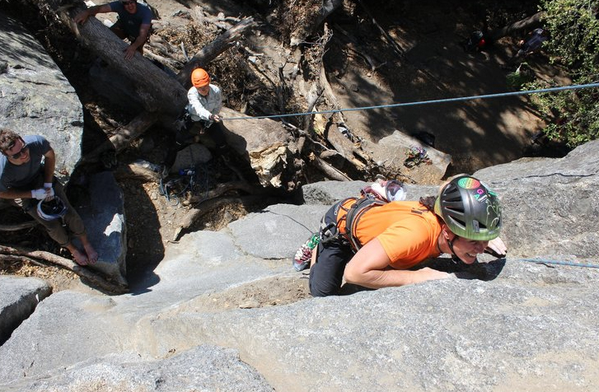
A human 3-way handshake protocol
1. On belay?
2. Belay on.
3. Climbing.
Notes:
As usual, there’s a human protocol analogy to the three way handshake, and I still remember thinking about this clinging for my life while climbing up a rockface
When you want start climbing you first say ON BELOW (meaning ARE YOU READY WITH MY SAFETY ROPE)
THE BELYER (server) responds BELAY ON (that lets you know the belayer is ready for you)
And then you say CLIMING
It’s amazing what can pass through your head when your clinging for your life o a

Slide 43
Closing a TCP connection
client, server each close their side of connection
send TCP segment with FIN bit = 1
respond to received FIN with ACK
on receiving FIN, ACK can be combined with own FIN
simultaneous FIN exchanges can be handled
Notes:
All good things must come to an end, and that’s true for a TCP connection as well.
And of course there’s a protocol for one side to gracefully close of a TCP connection using a FIN message, to which the other side sends a FINACK message and waits around a bit to respond to any retransmitted FIN messages before timing out.

